Slide 1


Slide 2
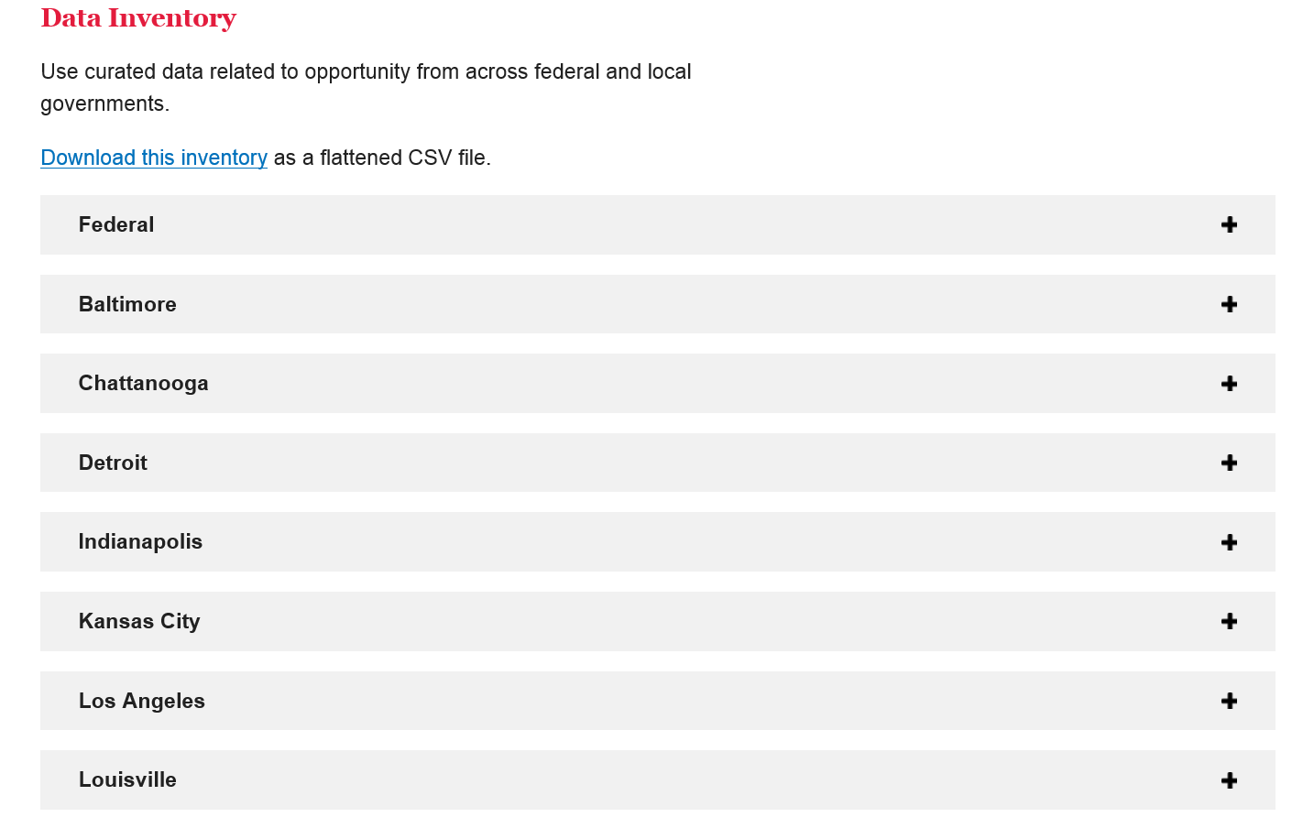

Slide 3
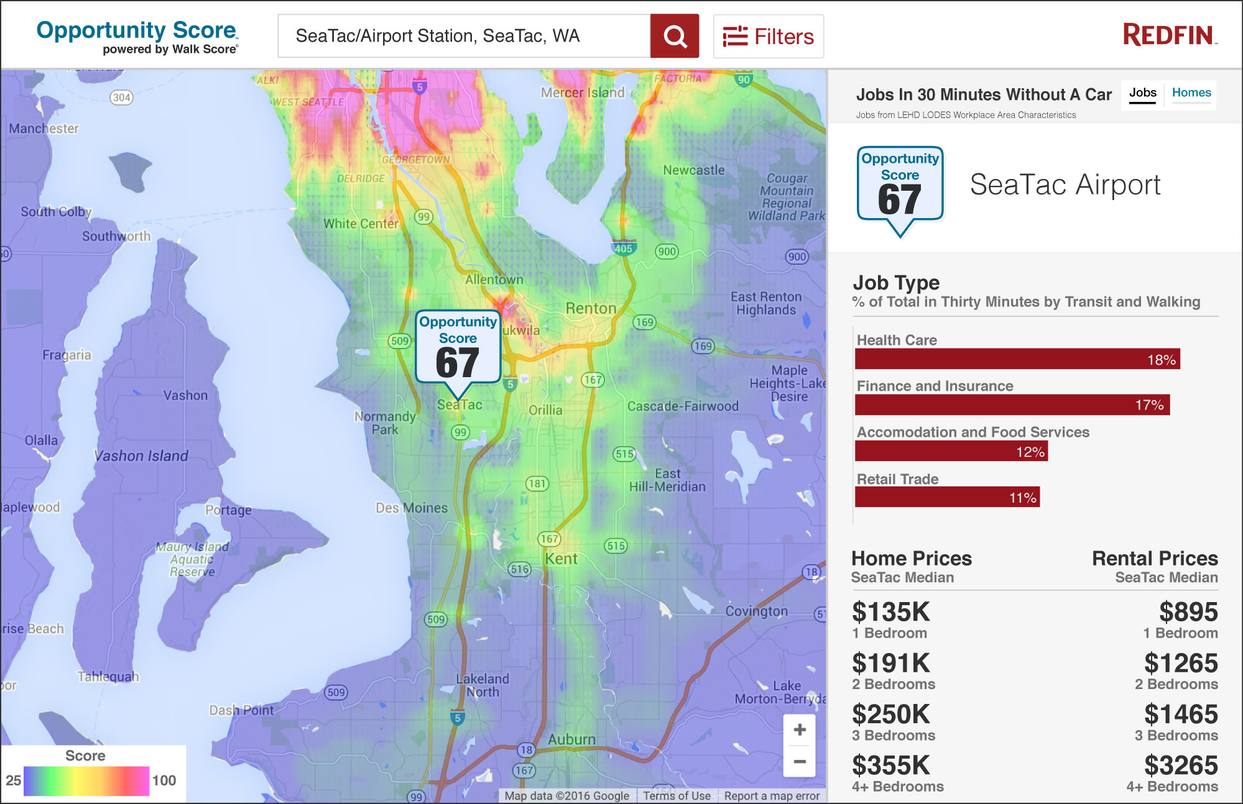

Slide 4
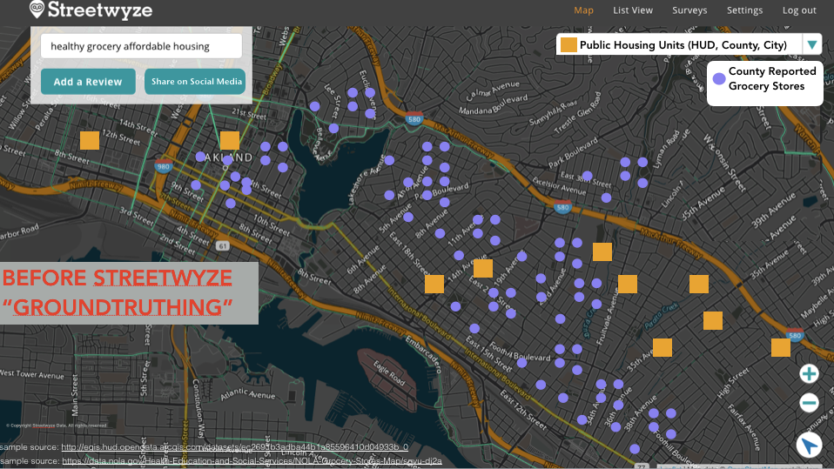
© Copyright Streetwyze Data. All rights reserved
Notes:
Streetwyze

Slide 5
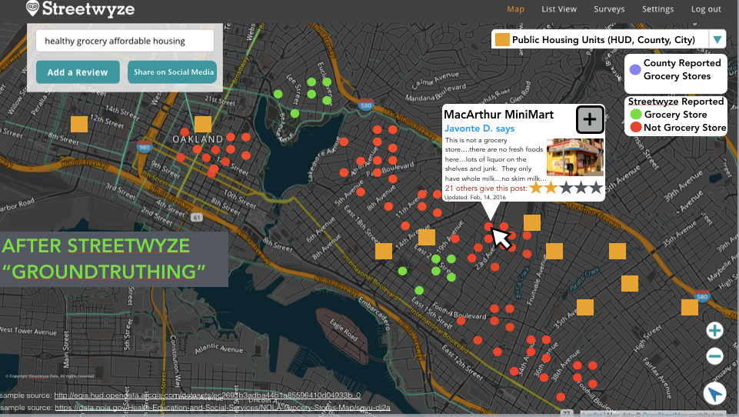
© Copyright Streetwyze Data. All rights reserved

